Slide 1
MICROSOFT CODE CONTRACTS
HP IS Team.

Slide 2
Contents
What is Hoare Logic?
What is Code Contract?
Defining Code Contracts ...
Static and Runtime checking...
Types of usage...
Real life usage scenario...

Slide 3
Hoare Logic
Hoare triple
{P} C {Q}
Preconditions
PostConditions
Invariants

Slide 4
Eiffel DbC
Bertrand Meyer - 1986
Eiffel was the first one which introduced DbC
Software failures are expensive
Reliability = Correctness + Robustness

Slide 5
Defining Code Contracts
Contract.Requires
Contract.Requires<Exception>
Legacy if throw block
Contract.EndContractBlock()
Argument validator methods

Slide 6
Defining Code Contracts
Contract.Ensure
Contract.EnsureOnThrow<Exception>
Special methods within Post Conditions
Contract.Result
Contract.OldValue

Slide 7
Defining Code Contracts
[ContractInvariantMethod]
Private void ObjectInvariant()
Contract.Invariant
Not checked for finalizers and dispose methods

Slide 8
Defining Code Contracts
Contract.Assert
Contract.Assume

Slide 9
Defining Code Contracts
Contracts on Interfaces
ContractClass
ContractClassFor
Contracts on Abstract methods

Slide 10
Contract Inheritance
Behavioral subtyping
Preconditions and Inheritance
Custom Parameter Validation
Object invariants and Inheritance

Slide 11
Visual Studio Integration
Static contract checking
Specified code base
Runtime contract checking
Contract rewritter

Slide 12
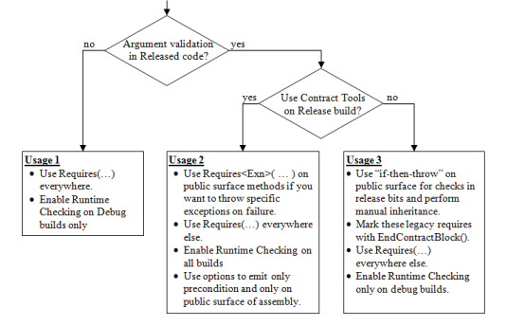
Usage scenarios

Slide 13
Real life usage scenario
Example

